Slide 1
The PEPPER Trial Coordinator Training February 2022

Slide 2
PEPPER Team: Executive Oversight Committee
Vincent Pellegrini, MD
Principle Investigator and Director, Clinical Coordinating Center, MUSC
Patricia Franklin, MD (Co-I)
PI, AHRQ FORCE Registry, U of Massachusetts
Les Lenert, MD, MS (Co-I)
Director, Biomedical Informatics, MUSC
Jay Magaziner, PhD (Co-I)
U. of Maryland, Baltimore
Larry Magder, PhD (Co-I)
Director, Data Coordinating Center, U of Maryland, Baltimore
Brook Martin, PhD
Statix, LLC.

Slide 3
PEPPER Clinical Coordinating Center Team
Vincent Pellegrini, MD
Principal Investigator
Monica Baczko, MPA
IRB Liaison
George Brown
Fiscal Analyst
Meghan Washburn
Grants and Contracts
Carol Lambourne, MSc, Phd
Program Director
Laura Kernan, MSc.
Clinical Site Liaison
Lauren Card
Events Administration
Kathy Weatherford
Program Administrator

Slide 4
Protocol Overview
The PEPPER Trial:
Comparative Effectiveness of
Pulmonary Embolism Prevention after hiP and kneE Replacement:
Balancing Safety and Effectiveness
Sponsor: DHMC and MUSC
Funding Source: PCORI (Patient-Centered Outcomes Research Institute)

Slide 5
Protocol Overview 2
Elective total joint replacement of the hip and knee make up the most commonly performed procedures in the US, totaling nearly 1 million procedures annually.
Readmission to the hospital within 90 days of operation occurs after 10-15% of elective hip and knee replacements and venous thromboembolism (VTE; blood clots in the veins), specifically pulmonary embolism (PE; blood clots in the lung), is one of the most common causes.
The purpose of this study is to improve health care and outcomes after hip and knee replacement by providing needed evidence to better inform patient and surgeon decision-making around the choice of drug regimen for prevention of VTE.
This study will look at the safety and effectiveness of three most commonly used anticoagulants in North America: enteric coated aspirin, low intensity warfarin, and rivaroxaban.

Slide 6
Protocol Overview 3
Primary Specific Aims
To compare the frequency of the aggregate primary clinical endpoints of important VTE (clinical PE and DVT leading to hospital readmission) and all-cause mortality (aggregate indicator of fatal events, including both PE and major hemorrhage related to anticoagulant use) among three different VTE prophylaxis regimens.
An audit of all hospital readmissions within 6 months of operation will be accomplished by routine postoperative follow-up through a mechanism of central telephone surveillance of patient-reported outcome events that is augmented by on-site research coordinator follow-up and validation of suspected endpoint events and adverse outcomes.

Slide 7
Protocol Overview 4
Primary Specific Aims
2) To compare the frequency and nature of bleeding complications (major, clinically important, and wound-related) leading to wound drainage, reoperation deep infection, or myocardial infarction among three different VTE prophylaxis regimens.
3) To compare the groups with respect to patient-reported outcomes in order to assess their impact on specific function of the replaced joint as well as general patient well-being.
Validated functional outcome tools will be compared among patients with and without primary endpoint events, as well as with historical baseline data warehoused in the FORCE registry, a national AHRQ funded joint replacement outcomes database. Study site overlap with the FORCE registry is planned.

Slide 8
Protocol Overview 5
Secondary Specific Aims
Analysis of the contribution of “standard of care” methods of anesthesia on clinical effectiveness of three different prophylaxis regimens.
Analysis of the relative frequency of thromboembolic events and bleeding complications between hip and knee replacement patients with each of the three regimens.
To compare patient preferences and risk tolerances (represented by the Patient Advisory Board) with those of physician stakeholders (Steering Committee minus patient members) to contrast two potentially disparate perspectives.

Slide 9
Eligibility Criteria
Inclusion Criteria:
Males and females 21 years of age or older
Undergoing elective primary, resurfacing arthroplasty, revision, or second stage re-implantation total hip replacement
Undergoing elective primary, revision, or second stage re-implantation total or uni-compartmental knee replacement
Patient is eligible for randomization to at least two of the study anticoagulant regimens
Patient has necessary mental capacity to participate and is able to comply with study protocol requirements
Patient is willing and able to give informed consent
Patient is willing to be randomized and participate

Slide 10
Eligibility Criteria 2
Exclusion Criteria:
Patients undergoing bilateral hip or knee replacement
Patients undergoing total hip or knee replacement who have been enrolled in this study for a prior hip or knee replacement;
Patients who are concurrently enrolled in another active interventional clinical trial testing a drug or intervention known or believed to interact with aspirin, warfarin, or rivaroxaban.
Women who are pregnant or breastfeeding, as well as those of reproductive potential unless there is a negative urine pregnancy test on the day of surgery
Patients on chronic (longer than the prior 6 months) anticoagulation other than with antiplatelet medications

Slide 11
Eligibility Criteria 3
Exclusion Criteria (cont.):
Patients with documented gastrointestinal, cerebral, or other hemorrhage within 3 months of the operation
Patients with a known diagnosis of defective hemostasis and past history of clinical bleeding requiring transfusion and treatment
Patients who have had an operative procedure involving the eye, ear, or central nervous system within one month
Patients with severe uncontrolled hypertension with systolic BP > 220mmHg or diastolic BP > 120mmHg
Patients with an absolute body weight of less than 41 kilograms (90.4 lbs) at baseline visit
Vulnerable patient populations including prisoners and institutionalized individuals

Slide 12
Risks
Risks to human subjects in this trial include any and all of those typically experienced in the course of “standard of care” treatment and prophylaxis for venous thromboembolism after total hip or knee replacement. There are no experimental drugs or treatment regimens involved in this trial, and so there are no risks associated with any experimental interventions.
Randomization Risks: Patients will be assigned by chance and may receive treatment that proves to be less effective or to have more or fewer side effect that the other study treatments or other available treatments.
Confidentiality Risks: loss of confidentiality of PHI.
Pregnancy Risks: it is unknown whether the study drugs will affect mother’s milk or an unborn fetus.
Unknown risks

Slide 13
Risks 2
Medication Risks: Each of the anticoagulants carries a risk of bleeding, reoperation to evacuate a hematoma from the incision, and secondary infection of the hematoma
Aspirin: may cause gastritis and intestinal bleeding may result, or patients may develop an allergy to aspirin that interferes with breathing
Warfarin: Warfarin may accumulate in patients who have liver disease or result in an idiosyncratic reaction with elevation of the INR and may require reversal
Rivaroxaban: Rivaroxaban may accumulate in patients who have kidney disease and may require reversal
Medication | Reoperation for Bleeding | Pulmonary Embolism
Aspirin | 1 in 500 (0.2%) | 1 in 50 (2.0%)
Warfarin | 1 in 100 (1.0%) | 1 in 100 (1.0%)
Rivaroxaban | 1 in 20 (5.0%) | 1 in 200 (0.5%)

Slide 14
Study Design
Total study period will encompass 4 ½ years:
6 months of preliminary work
3 years of patient enrollment (Start date 12/1/16)
6 months trailing follow up after enrollment closure
6 months of final data analysis
*recruitment period has been extended and is currently expected to continue until summer 2023*
Enrollment Goals:
Approximately 20,000 patients enrolled nationwide
1,000 patients per site (and continuing until overall study enrollment goal is met)
Approximately 333 patients per year; 7 patients per week

Slide 15
Recruitment Plan
The ESSENTIAL ingredient for success…
While we ALL have our biases about preferred VTE prophylaxis after THA and TKA, NONE of us have a valid evidenced-based answer.
Participation in this trial is predicated on your ability to leave your inherent bias at the door, and genuinely attempt to enroll every patient who meets eligibility criteria for randomization, even if stratified to only two drugs.
We NEED the commitment of EVERY participating surgeon to recruit EVERY eligible patient into the trial. We must eliminate personal subjective selection bias.

Slide 16
PEPPER Recruitment
Initial Discussion with Surgeon
Pre-Screening
In-Person Recruitment
Remote Recruitment
Screening/Enrollment

Slide 17
Recruitment: Initial Discussion
At the time the surgeon and the patient decide to proceed with surgery, the surgeon will give a brief introduction to PEPPER
IRB brochure will be given to the patient to bring home
We will provide a link to the public PEPPER website

Slide 18
Recruitment: Initial Discussion
Patients will be given a tri-fold brochure at the initial visit when surgery is discussed and scheduled

Slide 19
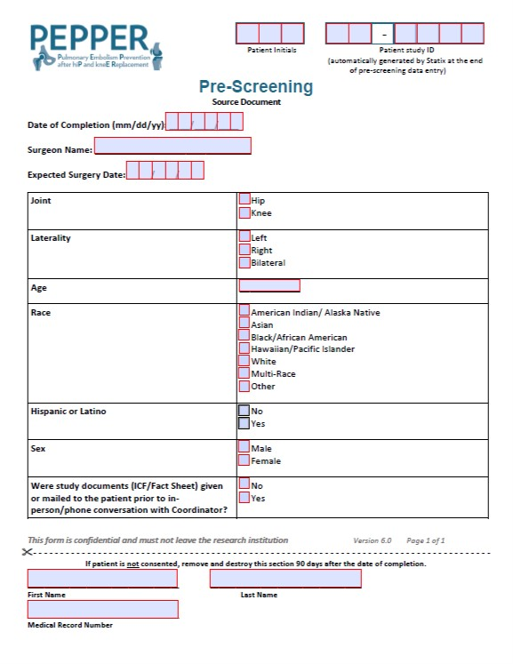
Recruitment: Pre-Screening
All patients scheduled for knee/hip surgery with a participating PEPPER surgeon should be pre-screened using the Pre-Screen CRF and Statix database
Patient ID numbers will be generated in Statix

Slide 20
Recruitment: In-Person
The PEPPER site coordinator and/or surgeon meets with potential participants in person
Study is reviewed
Informed Consent is completed
On paper or via REDCap e-consent database
A copy of the signed consent form is given in person, mailed, or emailed to the participant based on their preference.
Patient Contact Form CRF and Baseline Survey are completed by the patient either on paper or via REDCap.

Slide 21
Recruitment: Remote
Remote recruitment will occur either when a potential patient has requested more time to review the study after an in-person meeting or when the patient is unable to be seen during an in-person surgical clearance visit.
The potential participant must have the appropriate capabilities to access REDCap (i.e computer, smartphone, or tablet, and an internet connection) and must be in a private location during the consenting process.
Coordinator will contact patient via phone or video conference
Study is reviewed
Informed Consent, contact information, and Baseline survey are completed via REDCap database
Detailed REDCap e-consent instructions are available on the PEPPER website

Slide 22
Recruitment: Important Information
Point to emphasize to patient:
The drugs are not experimental
The drugs are all FDA approved
These are the most common blood thinners prescribed to patients in North America after this type of procedure
Their surgeon would more than likely prescribe one of these 3 drugs if not involved in the study
Their surgeon will sign off on their eligibility
No additional testing or appointments needed for the study

Slide 23
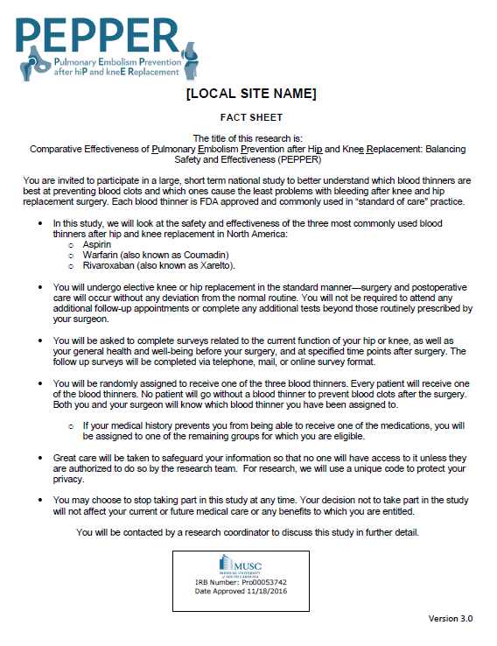
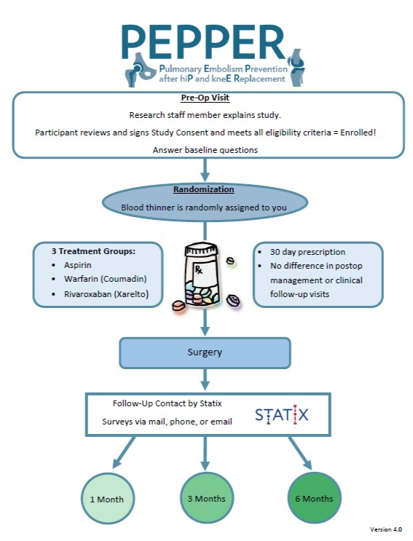
Recruitment Tools
Fact Sheet:
can be given to patients with the brochure or mailed prior to consenting visit
Study Design Diagram:
Useful when shown during the consenting meeting. Restricted Randomization versions are available.

Slide 24
Validity of Baseline Surveys
Baseline Instruments must be completed within 3 months of the operation to be considered valid
If a patient is consented and completes the baseline but the surgery is rescheduled to occur mor than 3 months after the initial baseline visit, the patient must be reevaluated for eligibility criteria and complete a new baseline survey
Patient will keep the same Statix ID number
The ICF is still valid and re-consenting is not necessary

Slide 25
PHI on Data Collection Forms
The PEPPER study has been approved with a waiver of consent to allow coordinators to view the patient’s medical record and retrieve eligibility criteria prior to consent
If a patient does not consent to be in the study due to refusal or ineligibility, any form that is completed prior to consent (i.e. Pre-Screen form) must have the PHI removed from the form.
Cut the bottom of paper versions
Delete information from electronic versions

Slide 26
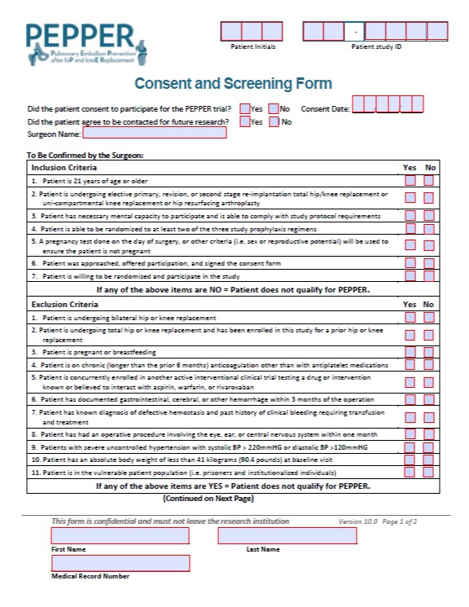
Recruitment: Consent and Screening Form
Once the patient consents, coordinator will review the eligibility criteria with the patient (and EMR)
Contraindication questions (2nd page) will also be reviewed
Coordinator will sign the form where indicated on the 2nd page

Slide 27
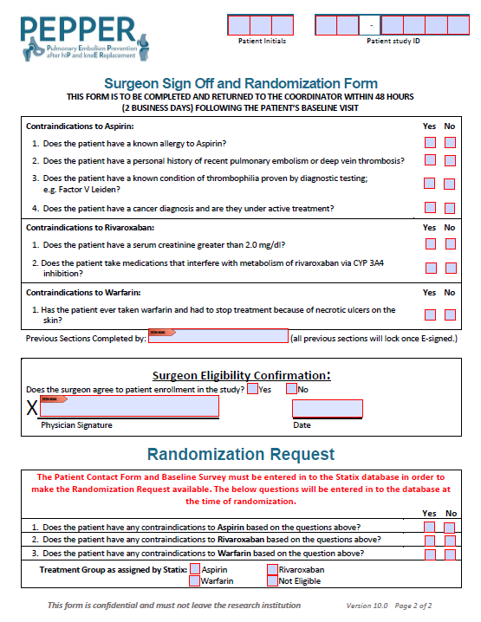
Recruitment: Consent and Screening Form
Forms for eligible, consented patients will be sent to the appropriate surgeon
Surgeon will confirm eligibility and sign/date the form
Only when the surgeon has signed and returned the form to the coordinator can the patient be screened in Statix

Slide 28
Recruitment: Consent and Screening Form
All patients with a Statix ID will have a screening form completed in Statix regardless of eligibility.
Eligible, consented patients will be screenpassed
Ineligible patients and patients who refuse to participate will be Screenfailed in Statix.

Slide 29
Pregnancy Testing
Women who are pregnant or breastfeeding are not eligible to participate in this trial.
Women who are of reproductive potential who do not have a pregnancy test on the morning of surgery are not eligible.
Women of child-bearing potential must have a negative urine pregnancy test on the morning of surgery.
The patient is considered eligible for randomization once all eligibility criteria (except a negative pregnancy test, if necessary) are met.
Study medication CANNOT be given to women of child-bearing potential unless the test is negative.
Results of this test will be documented on the Surgical Adherence Form following surgery.
In order to screen the patient and randomize her, the eligibility criteria on the screening form will be marked off appropriately. The surgery data form will have a place to enter if the patient had a positive pregnancy test.
If a woman of child-bearing potential has a POSITIVE pregnancy test, or does not have a pregnancy test on the morning of surgery, she will be considered a Screen Fail
Patient has failed an eligibility criteria
We would not have to follow the patient through pregnancy and delivery

Slide 30
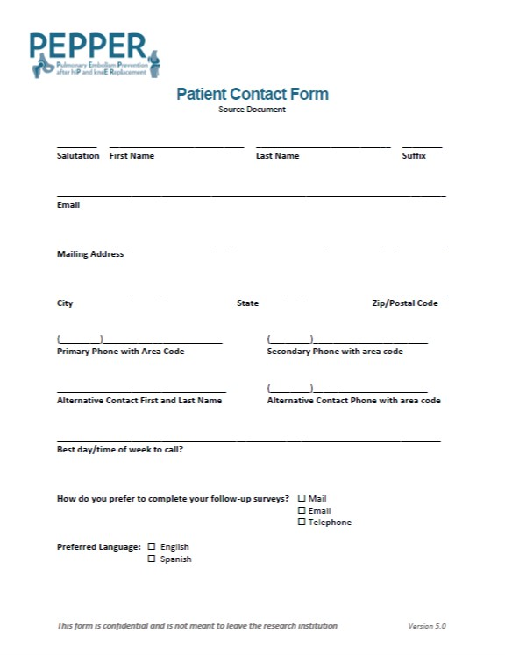
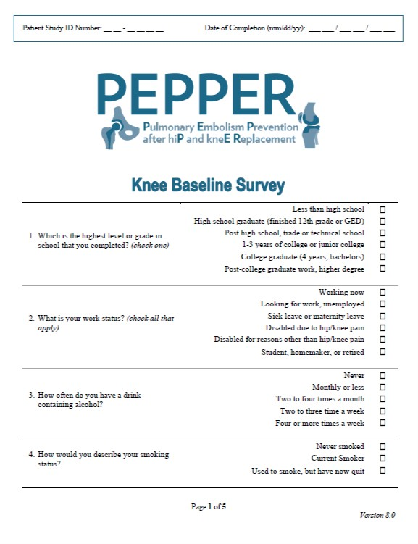
Recruitment: Patient Baseline Forms
Patient Contact Form
Baseline Knee Survey
Baseline Hip Survey
The randomization form in Statix will become available once the Pre-Screen, Screening, Contact, and Baseline forms have been entered.

Slide 31
Recruitment: Randomization
Randomization can only occur after the surgeon has confirmed eligibility and before the day of surgery
Contraindications to the medications will determine which treatment group the patient will be assigned to.
Record the randomization assignment given via Statix on the Randomization CRF

Slide 32
Study Medications
Treatment Groups
Aspirin
Enteric coated
162 mg given in the morning prior to surgery
81 mg BID beginning on POD1
Warfarin (Coumadin)
Initial dose based on weight given in the morning prior to surgery
2.5 mg <125 lbs
5mg 125-250 lbs
7.5 mg >250 lbs
If given prior to 12pm, a second dose will be given in the evening (also based on weight)
POD1: in the evening based on target INR value of 2.0 (range 1.7-2.2)
Rivaroxaban (Xarelto)
10mg given 24 hours after patient reaches the recovery room (+/- 2 hour window)

Slide 33
Study Medications
Patients on preoperative cardiac dose aspirin
Randomize to Aspirin:
May continue their usual dosing regimen prior to the morning of surgery, and then commence the PEPPER trial aspirin dose
Randomized to Warfarin or Xarelto:
May continue their aspirin regimen throughout the trial

Slide 34
Statix 2.0 is finally live!
Go Live date: 7/5/2021
https://live.statix.com/

Slide 35
Browser Compatibility
The Statix database is best used with the following browsers:
Chrome
Firefox
Edge
Please avoid using Internet Explorer as we have noticed glitches and errors.

Slide 36
Accessing the Database
https://live.statix.com/
Upon first log-in, choose “Via Email” to receive your Two Factor Authentication code
Edit your account after first log-in to add your phone number for text codes.
Email codes: 6 digits
SMS Text codes: 4 digits
Two Factor Authentication is only required every 12 hours

Slide 37
Training in PLAYGROUND
When first accessing Statix 2.0, you will be released into the PLAYGROUND site (site 40)
Only faux patient data should be entered in this site.
Once you have been fully trained and are comfortable entering data and navigating Statix, you will be moved over to your appropriate site.

Slide 38
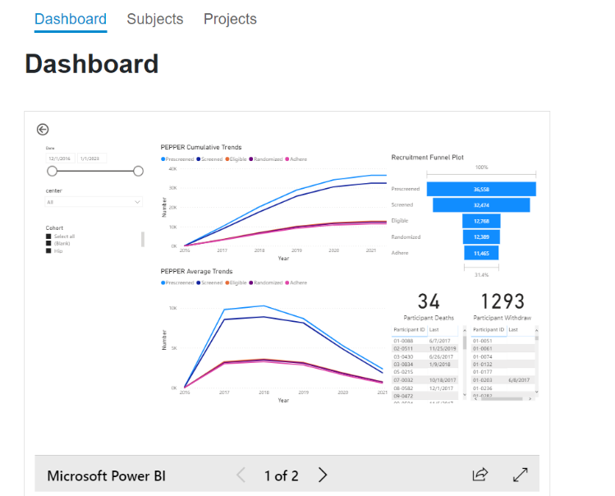
Dashboard and Power BI
Navigation menu
Dashboard
Subjects (formerly Participants)
Projects
My Account
Logout
Power BI Reports
Coming soon!

Slide 39
Visual Progress Tool
Separated by Project (Knee/Hip)
Shows patient status and their progression through the study
Color coded to easily see what forms have been completed, are lost, are missing, or are no longer needed
Columns can be sorted to group similar patients together

Slide 40
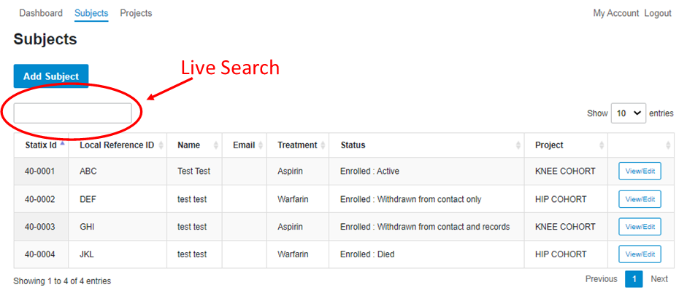
Subject Search and View
Located in the “Subjects” link
Includes ID, Initials, Name, Email, Treatment Assignment, Status, and Project
Can search by all columns (i.e. pull up all patients who are randomized to warfarin; pull up all deceased patients, etc.)

Slide 41
Subject Search and View (cont’d.)
View/Edit subject Page displays all information related to the patient
Subject Details
Surveys
Contact
Preference
Attempt Log

Slide 42
Subject Search and View (cont’d.)
Subject Details

Slide 43
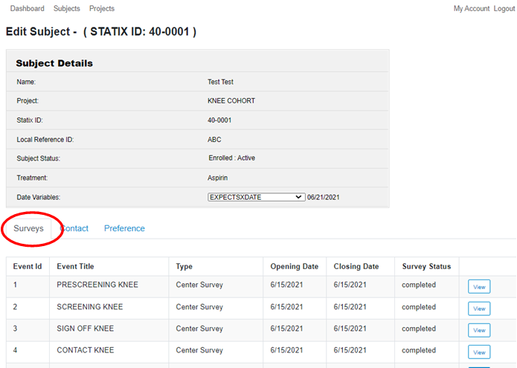
Subject Search and View (cont’d.)
Surveys

Slide 44
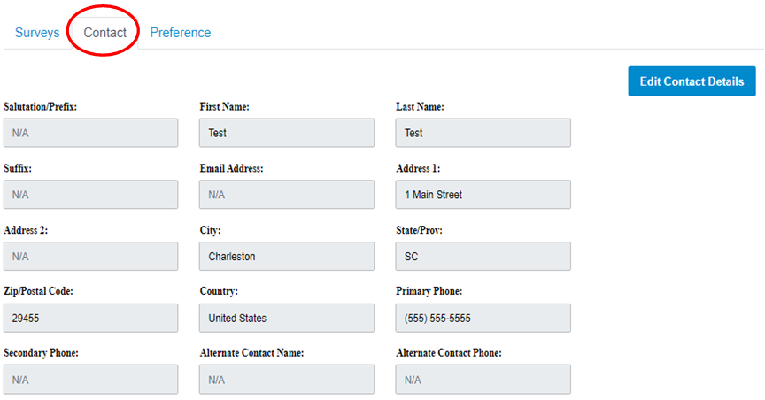
Subject Search and View (cont’d.)
Contact
*Information on this page will update once the Contact Survey has been entered*

Slide 45
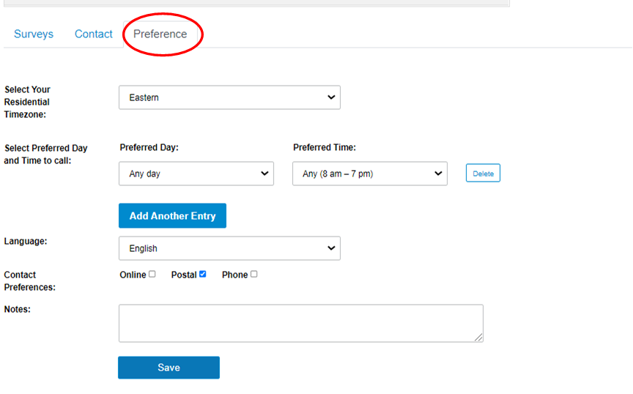
Subject Search and View (cont’d.)
Preference
*Information on this page will update once the Contact Survey has been entered*

Slide 46
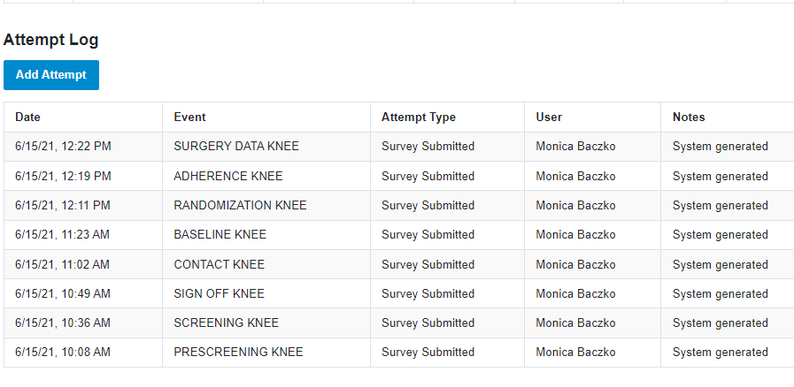
Subject Search and View (cont’d.)
Attempt Log
*”Add Attempt” will mainly be used by Statix Interviewers. Specific Reporting Forms have been added for all status changes*

Slide 47
Subject Statuses
Not Screened
Patient has been pre-screened only
Screenpass
Consent signed, patient met all eligibility, screening forms completed
Screenfail
Patient has not met eligibility criteria, screening form(s) completed to reflect ineligibility
Enrolled: Active
Patient has been randomized

Slide 48
Subject Statuses (cont’d)
Enrolled: Withdrawn from contact only
Patient is still enrolled but will not be contacted for survey completion. Site is responsible for gathering outcomes via EMR review at 6-month time point
Enrolled: Withdrawn from contact and records
Patient has been completely withdrawn from PEPPER
Enrolled: Died
Patient reported as deceased
Completed:
Patient has passed through the 6-month follow up time point

Slide 49
Entering Data
All surveys are 1 page with all questions displayed on the same page.
To change this, click the “toggle to change view” button
Tab through questions using a combination of the tab and spacebar or arrows.
For text fields, hit the tab button twice
Dates fields can be manually entered by typing the numerical date
Required questions are indicated by a red asterisk
If missed, you will be prompted to go back and answer

Slide 50
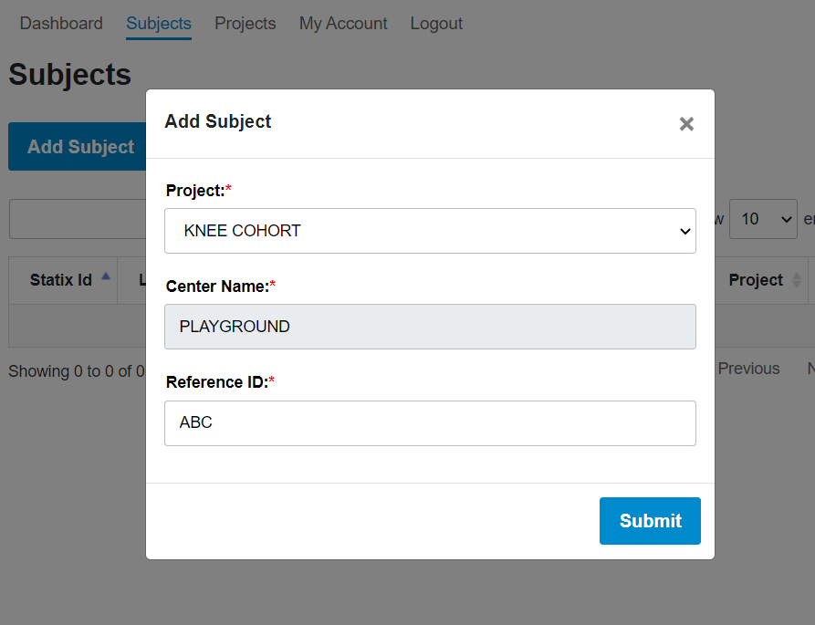
Entering Data: Add a Patient
Click the Subjects tab
Click the blue Add Subject button
Pop up appears to allow for project choice and entry of patient initials (Reference ID)
**Projects cannot be changed, so please be mindful when making this selection**

Slide 51
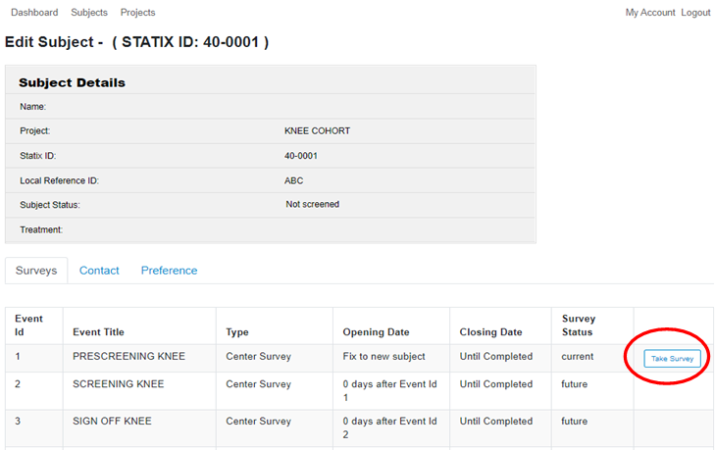
Entering Data: Pre-Screen
The only available form is the PRESCREEN
Click the “Take Survey”

Slide 52
Entering Data: Screening Forms
Screening Form
Click “Take Survey” button
Auto Screening will automatically answer all questions to result in a Screenpass.
If a patient Screenfails, a warning message will appear

Slide 53
Entering Data: Screening Forms (cont’d)
Sign Off Form
Opens once SCREENING is completed and patient screenpasses.
Contains:
consent date
future research question
contraindication questions
**Restricted Randomization sites will see all questions**
surgeon sign off question
Surgeon sign off question must be marked “Yes” in order to Screenpass the patient.

Slide 54
Entering Data: Cont’d
Forms will become available as data is entered
Patient is a Screenpass
CONTACT
BASELINE
RANDOMIZE
ADHERENCE/SURGERY DATA

Slide 55
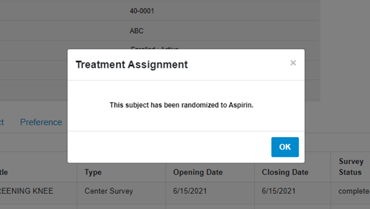
Entering Data: Randomization
Click “Take Survey”
Answer 3 Contraindication questions
If your site is on the restricted randomization protocol, you will only see two questions
Pop-Up will appear with treatment assignment

Slide 56
Entering Data: Periop Forms
The Surgical Adherence form and Surgery Data form both become available once the patient is randomized
Please enter these in a timely manner (i.e., 2 business days after surgery/discharge)
**Follow-up surveys are triggered by the Surgery Date on the Surgical Adherence Form**

Slide 57
Follow Up Surveys
The Follow Up survey windows are based on the surgery date and will open accordingly
Statix Interviewers are responsible for the 1-,3-,and 6-month survey data collection and entry
If the patient does not respond to the 6-month survey, the coordinator is responsible for either collecting the survey or performing a medical record review

Slide 58
Status Changes: No Contact, Withdrawals, and Deaths
Status changes can be made using the 3 reports at the bottom of the surveys table.
These become available once the patient has screenpassed.

Slide 59
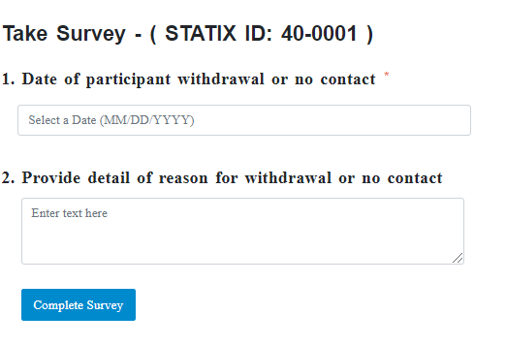
Status Changes: No Contact, Withdrawals, and Deaths (cont’d)
Each form contains
Date field: The date of event should be the date (or approximate date) that the event occurred, not the date it was discovered
Text Box: A detailed explanation of the event

Slide 60
Status Changes: No Contact
Patients can request to not be contacted by Statix to complete the follow-up surveys. If the patient agrees, coordinators will still view and collect any adverse events that may occur during the 6-month follow up window.
Click the “Take Survey” button associated with the REPORT NO CONTACT form
Enter the date that the patient requested to no longer be contacted and give a detailed explanation
The patient’s status will be listed as “Enrolled: Withdrawn from Contact Only”
All remaining follow-up surveys will become inactive
Adverse events and deaths should still be reported

Slide 61
Status Changes: Withdrawals
Patients will be withdrawn from PEPPER completely if
They no longer want to complete follow-up surveys or be contacted by Statix
They do not permit the study to retrieve additional information from their medical record at 6-months
Click the “Take Survey” button associated with the REPORT WITHDRAWN survey
Report the date of withdrawal in the date field and the reason why
Patient’s status will be listed as “Enrolled: Withdrawn from Contact and Records”
Adverse events and deaths that occur after the withdrawal date will not be collected.

Slide 62
Status Changes: Deaths
Deaths should be reported for any patient who is screenpassed and not formally withdrawn
If a patient is no longer being contacted by Statix for survey completion, deaths should still be reported
Click the “Take Survey” button associated with the REPORT DIED survey
Report the date of death in the date field and add any relevant information.
Patient’s status will be listed as “Enrolled: Died”

Slide 63
Transitioning From Statix 1.0 to 2.0
All patients who have passed screening in Statix 1.0 will remain in the 1.0 database
Patients will progress through the study as normal in 1.0 until they have completed (or are reported withdrawn/deceased)
All newly identified patients who require pre-screening will be entered in Statix 2.0

Slide 64
Transitioning From Statix 1.0 to 2.0 (cont’d)
Pre-Screening and Screening functionality will be turned off in Statix 1.0
To prevent any new patients from being added
To prevent any new screenings from occurring
Patients who have been pre-screened in 1.0 and are ready to be screened (either screenpass or screenfail) will be re-entered in to Statix 2.0, pre-screened, and screened as new patients

Slide 65
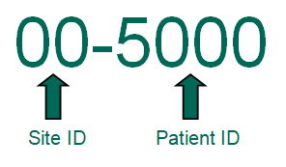
Transitioning From Statix 1.0 to 2.0 (cont’d)
Coordinators will be required to maintain patients in both databases for at least 1 year
As current 1.0 patients progress through the study
As new patients are entered and enrolled in 2.0
Statix 2.0 numbers will start off at a significantly higher number than 1.0 to easily distinguish between 1.0 patients and 2.0 patients.

Slide 66
Transitioning From Statix 1.0 to 2.0 (cont’d)
After approximately 1 year, Statix 1.0 patients who are “stuck” in certain stages will be withdrawn and/or purged on a case-by-case basis
i.e., patients who have been screened and/or randomized but do not have a scheduled surgery date
If these patients should return for surgery, they will be re-entered and given a new Statix ID in version 2.0

Slide 67
QUESTIONS?

